Slide 1
RENAISSANCE INTERACTIVE NOTEBOOK INFORMATION

Slide 2
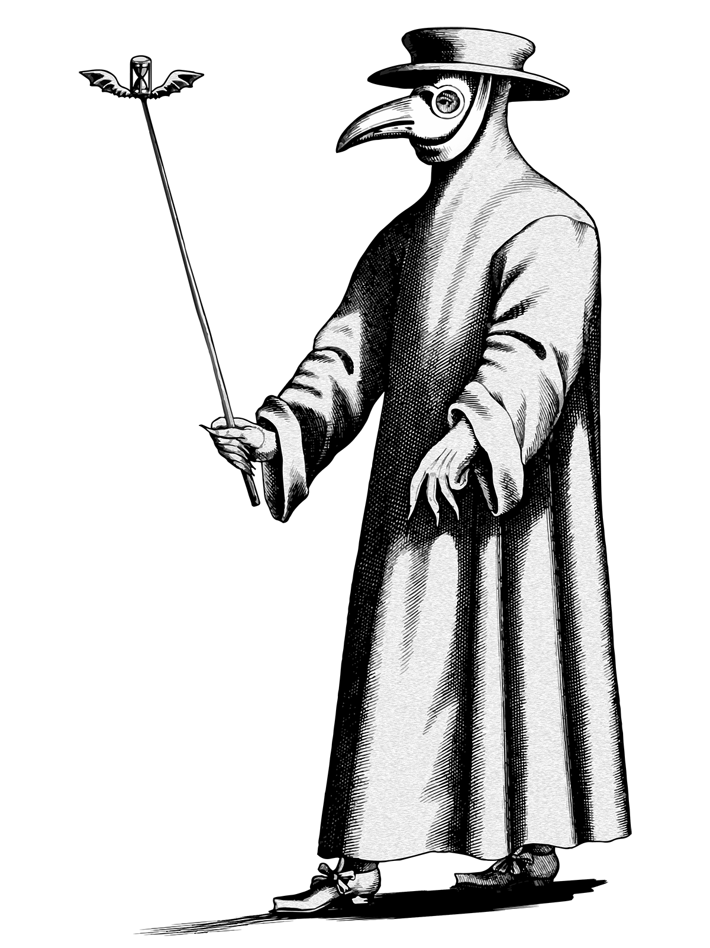
The bubonic plague
*also known as the Black Death
*started in Asia & travelled along the Silk Road
*arrived in Sicily in 1347
*took out 1/3 of Europe’s population, 1/2 of Asia’s population
Mask
-glass eyes
-beak held flowers & herbs
Leather Hat
Cane
-used to point to infected areas
Leather Gloves, Shoes, & Cloke
Fever & chills
Bleeding
Vomiting
Boils
Skin blackening (gangrene)
Abdominal pain & diarrhea

Slide 3
Renaissance in europe
“Rebirth”
1300s-1600s
Emphasis on the arts & sciences
Humanistic Movement
Looked back to teachings of Greeks & Romans
Florence, Italy was birthplace of Renaissance
Dark Ages
Famine
Disease
Poor living conditions
Faith & religion only
Finer Life
More luxuries
Nicer clothes
Cleaner towns
Emphasis on art, math, & science

Slide 4
The renaissance 1350-1600
Trade
Literature
Art
Learning
Sumptuary Law – laws made to restrain luxury or extravagance on moral or religious grounds (clothing, food, drink, etc.)
Byzantine – empire that was the Greek-speaking eastern part of the Roman Empire. Constantinople (capital) fell in 1453.
Reformation – 16th century movement for the reform of abuses in the Roman Catholic Church that led to the creation of the Protestant Church
Protestants – members of Western Christian churches that are separate from the Roman Catholic Church (Baptist, Presbyterian, Lutheran, etc.)
Humanistic – having a strong interest or concern for human welfare, values, & dignity
Renaissance – the revival of art, literature, & science during the 14th-16th centuries
Patrons – person who gives financial support to another person, group, or cause
Sfumato – technique allowing tones & colors to shade gradually into one another (Leonardo da Vinci)

Slide 5
Medici family
MEDICI LEGACY
Wool merchants & bankers
Very wealthy
Ruled Florence, Italy for 200 years
Financed many artists & scientists
COSIMO DE MEDICI
Gran Maestro (leader) of Florence in 1434
Started Medici dynasty
Supported Donatello & Brunelleschi
Pope Leo X –
Francesco –
Pope Clement VII –
Lorenzo –
Cosimo I –
Alesandro –
-Giovanni
-Cosimo
-Catherine
-Lorenzo the Magnificent
-Giuliano
-Piero

Slide 6
italy
LITERATURE
SHAKESPEARE
-Romeo & Juliet
CERVANTES
-Don Quixote
MILTON
-Paradise Lost
MACHIAVELLI
-The Prince
THE ARTS
Music based on modes
Used melodies
Religious & secular

Slide 7
EMPIRES OF THE RENAISSANCE
OTTOMAN EMPIRE
HOLY ROMAN EMPIRE
PAPAL STATES
FRANCE
SPAIN
ENGLAND
OTTOMAN EMPIRE
Conquered the Byzantine Empire
Ruler was called a Sultan
Renamed Constantinople to Istanbul
Ruled for 150 years

